Slide 1
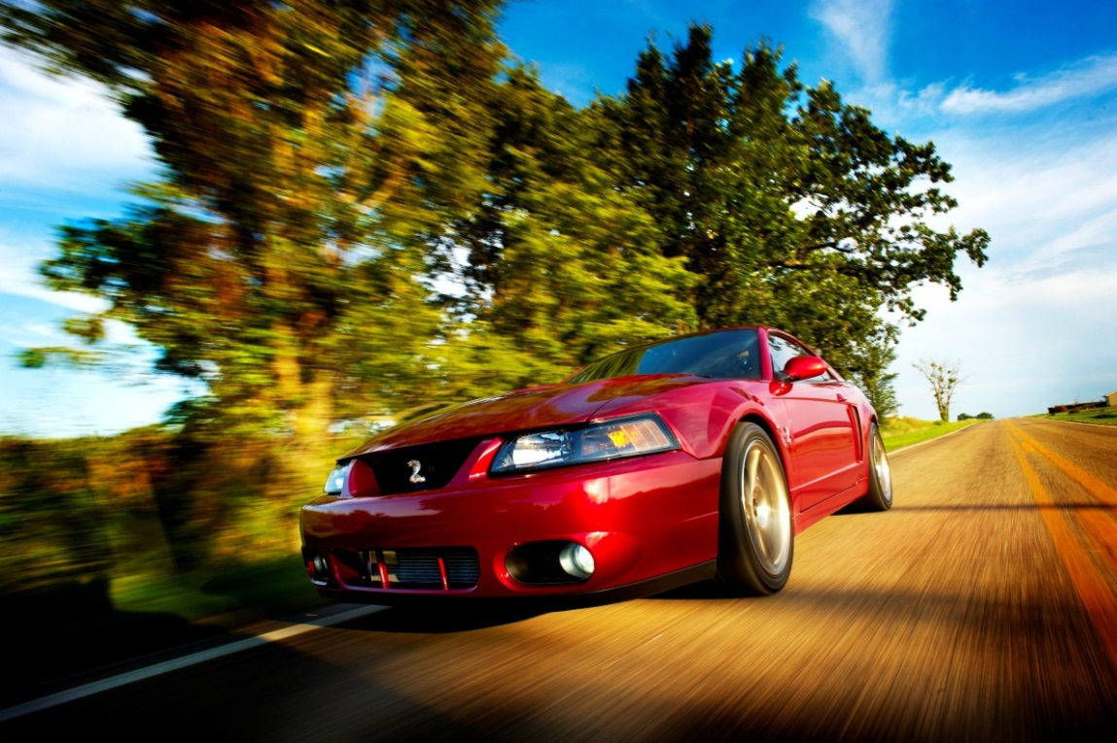
2003 Cobra Project and Background Brian Young bwyoung@mtco.com 309-264-7085 Main Project Build Thread http://www.svtperformance.com/forums/pics-videos-buffet-149/659614-cam-covers-afco-kb-2-2-03-cobra-installation-pictures-some-assembly-req.html

Slide 2
Project Threads on www.svtperformance.com
Main Cobra Project Build Thread (Currently ~28,500 views)
http://www.svtperformance.com/forums/pics-videos-buffet-149/659614-cam-covers-afco-kb-2-2-03-cobra-installation-pictures-some-assembly-req.html
Cobra 14in Rear Brakes
http://www.svtperformance.com/forums/suspension-modifications-211/776607-14-rear-brake-kit-venom-technologies-installation.html
Cobra Project Parts
http://www.svtperformance.com/forums/pics-videos-buffet-149/657664-new-03-cobra-install-parts-pics-kb-2-2l-redfire-cam-covers-hids-afco.html
Cobra Underside Cleaning
http://www.svtperformance.com/forums/pics-videos-buffet-149/853019-washed-2003-cobra-underneath.html
Cobra Polished Driveshaft
http://www.svtperformance.com/forums/pics-videos-buffet-149/855119-detailing-underside-my-cobra-polished-driveshaft.html
Cobra Paint Polishing and Detailing I
http://www.svtperformance.com/forums/pics-videos-buffet-149/857343-polished-my-redfire-cobra.html
Cobra Paint Polishing and Detailing II
http://www.svtperformance.com/forums/shownshine-saloon-190/709578-detailing-redfire-cobras-paint.html
Cobra IRS Fuel System Exhaust Polishing
http://www.svtperformance.com/forums/terminator-talk-229/650821-parts-installed-irs-brace-fuel-system-polished-exhaust.html
Cobra Framed Rolling Pictures
http://www.svtperformance.com/forums/pics-videos-buffet-149/748643-my-new-framed-cobra-action-pictures-posters.html
Cobra Rolling Pictures
http://www.svtperformance.com/forums/pics-videos-buffet-149/712814-lets-roll-baby.html

Slide 3
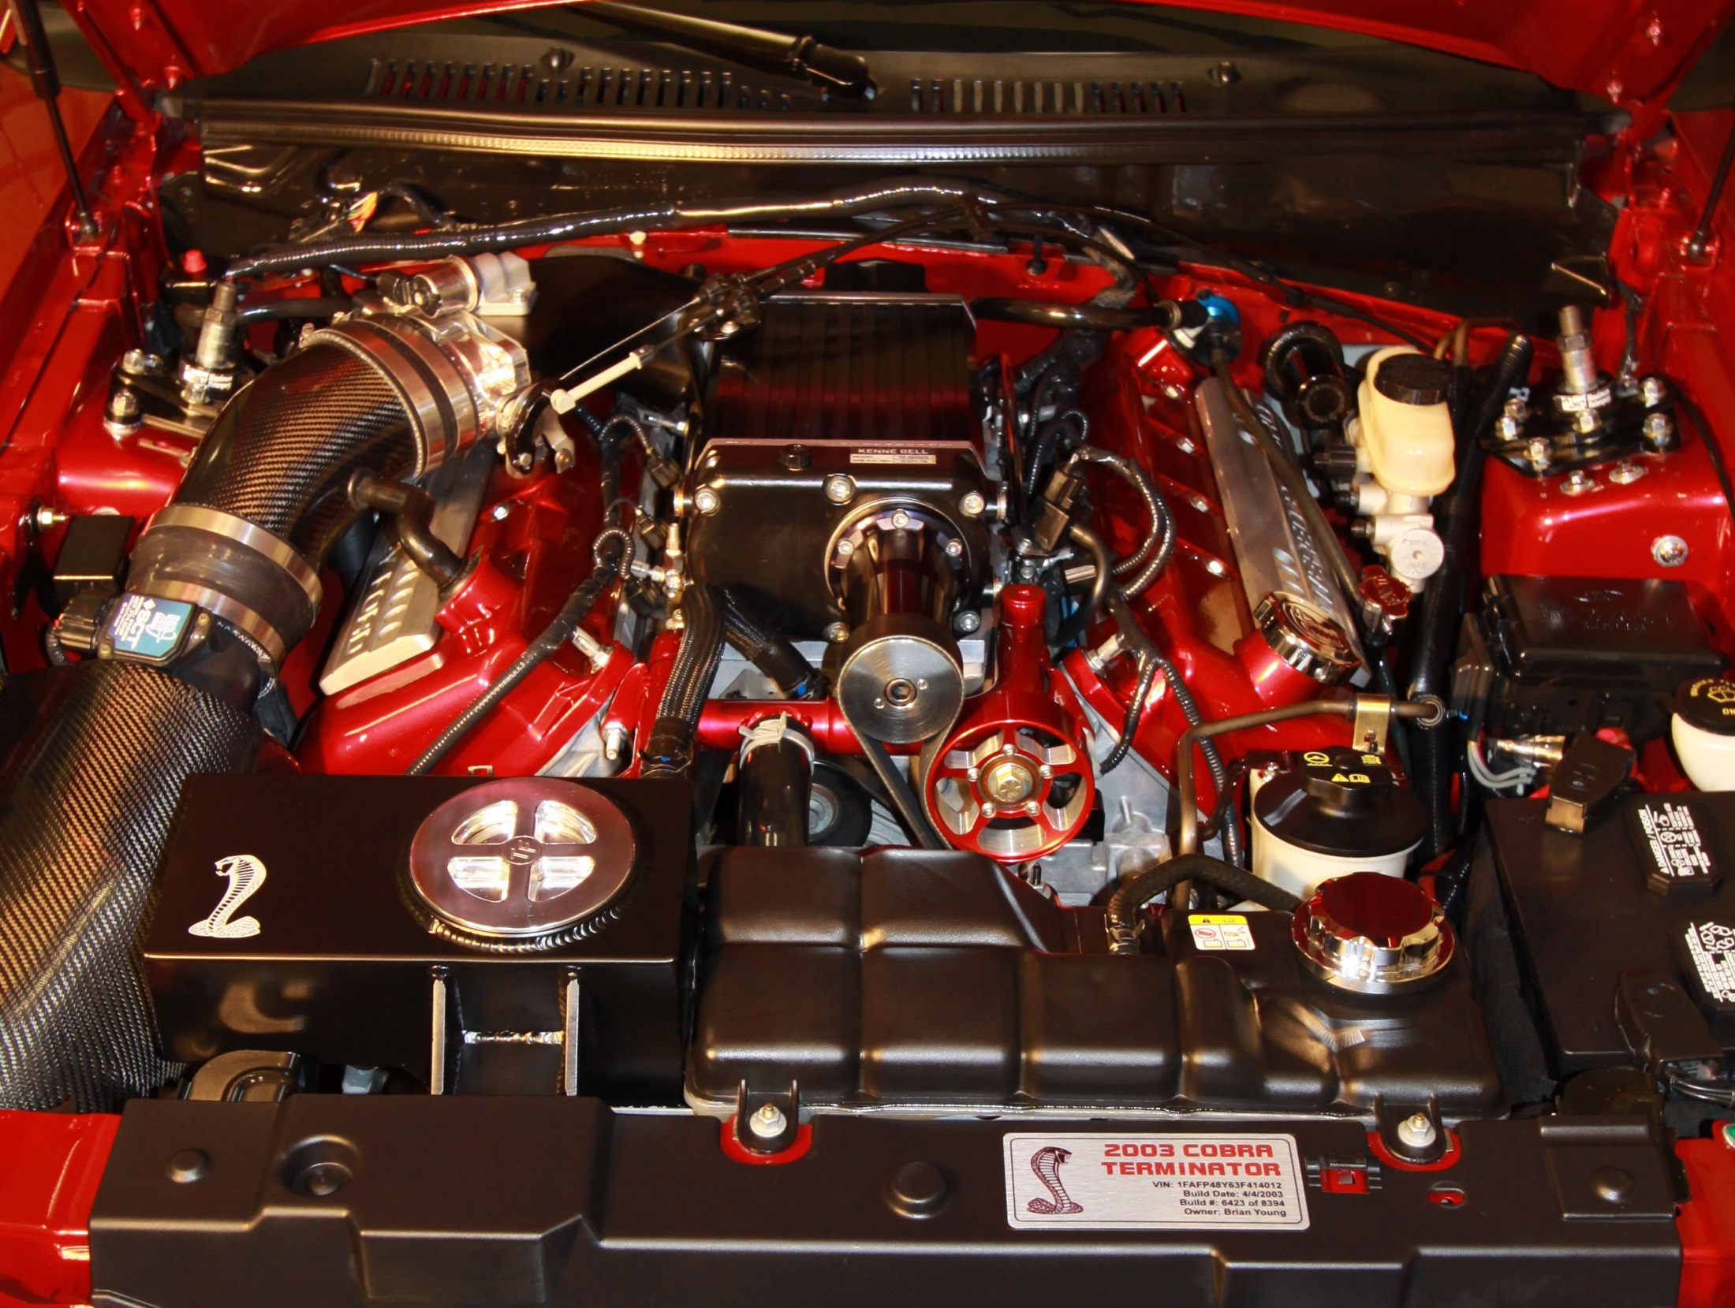

Slide 4
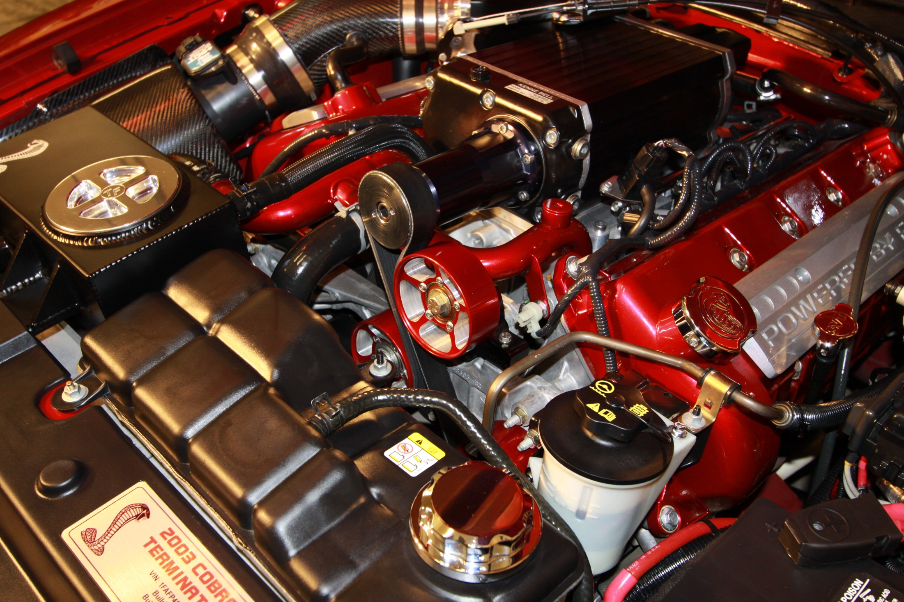

Slide 5
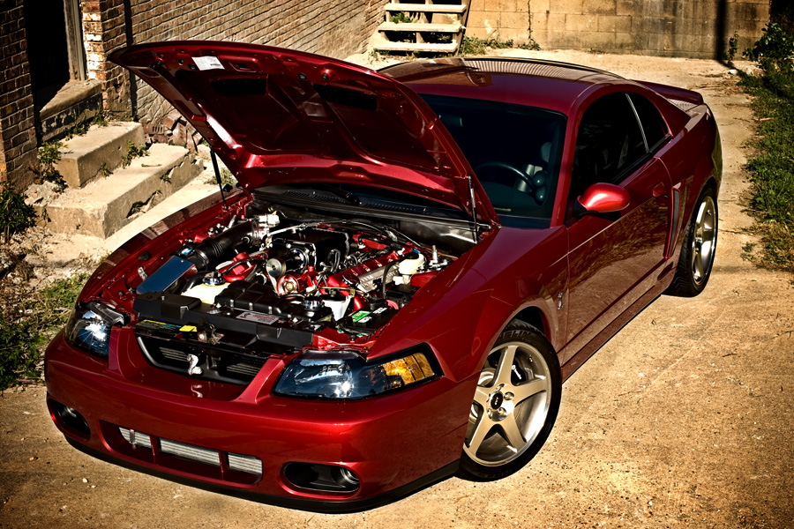
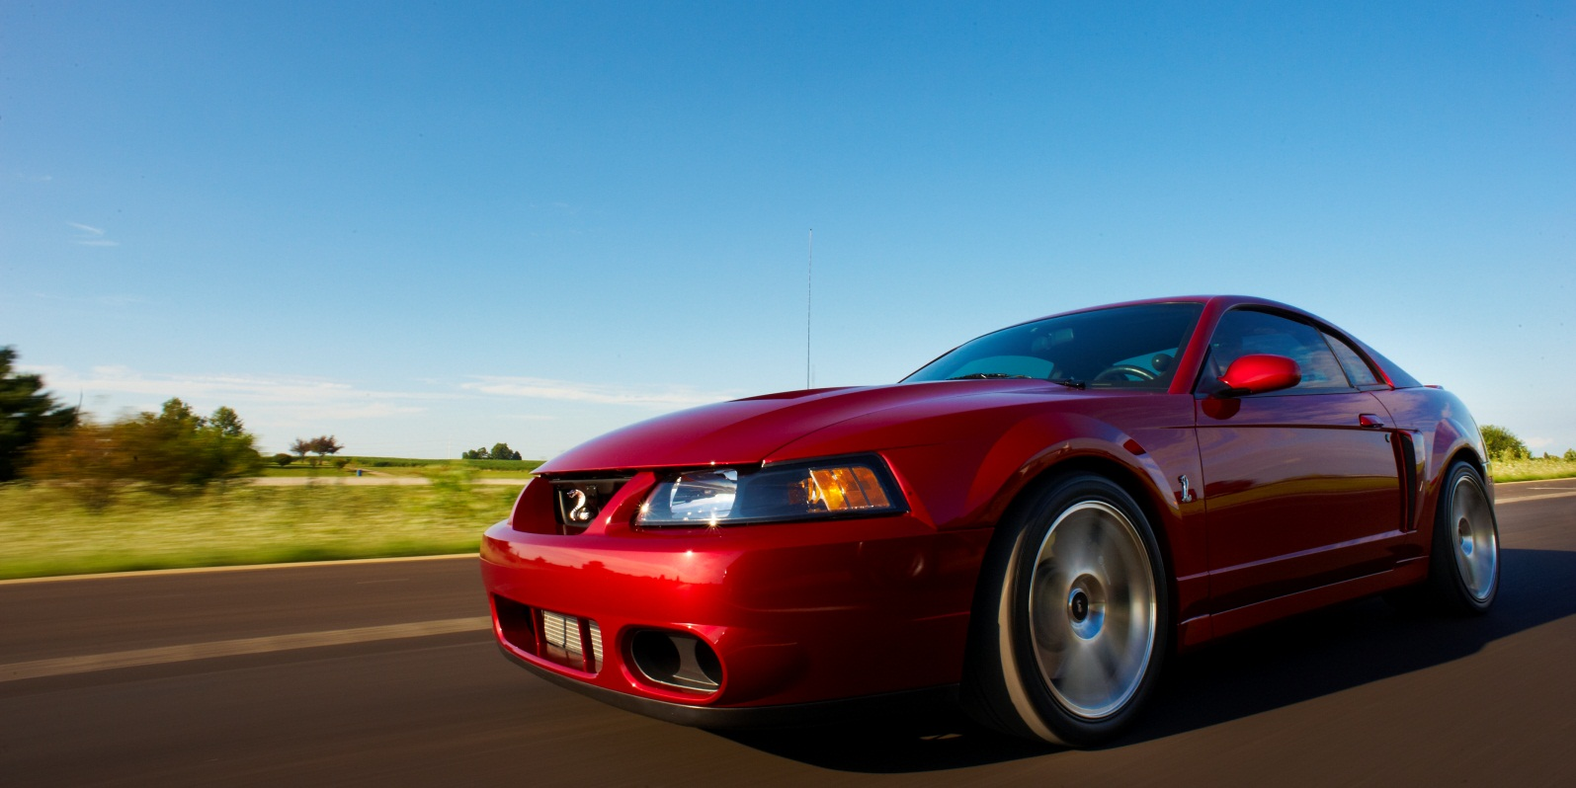

Slide 6
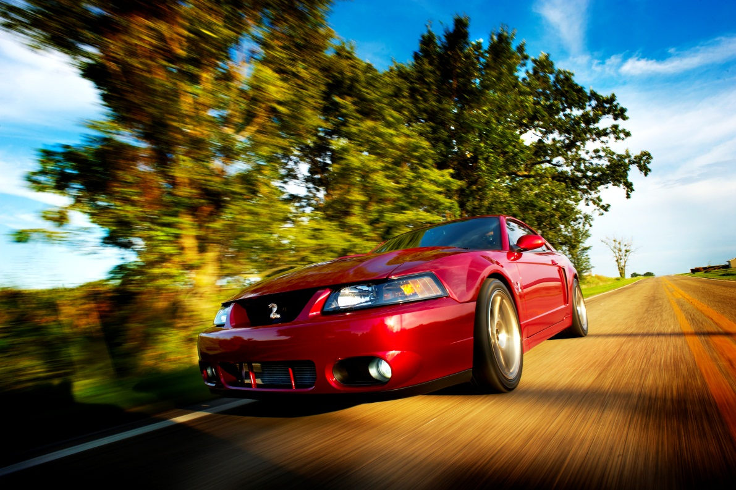
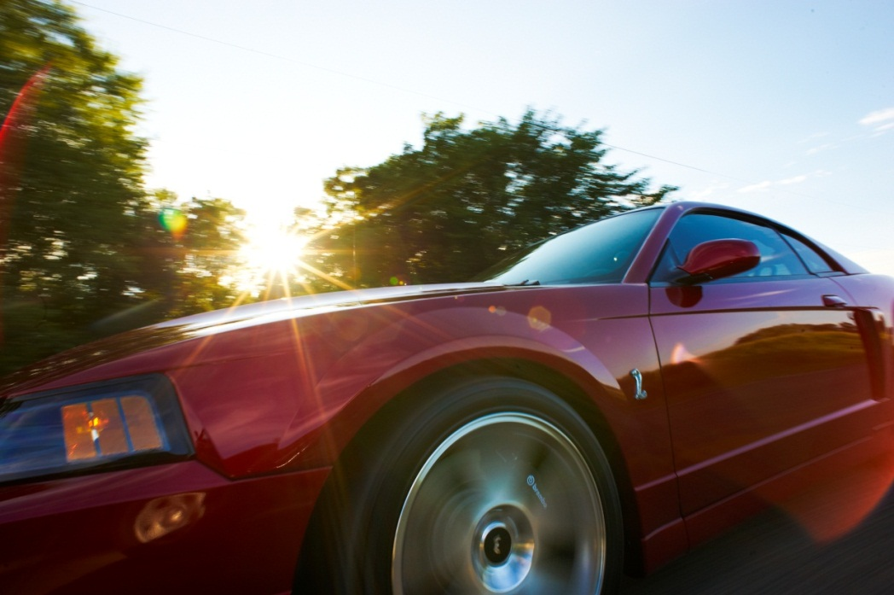


Slide 7
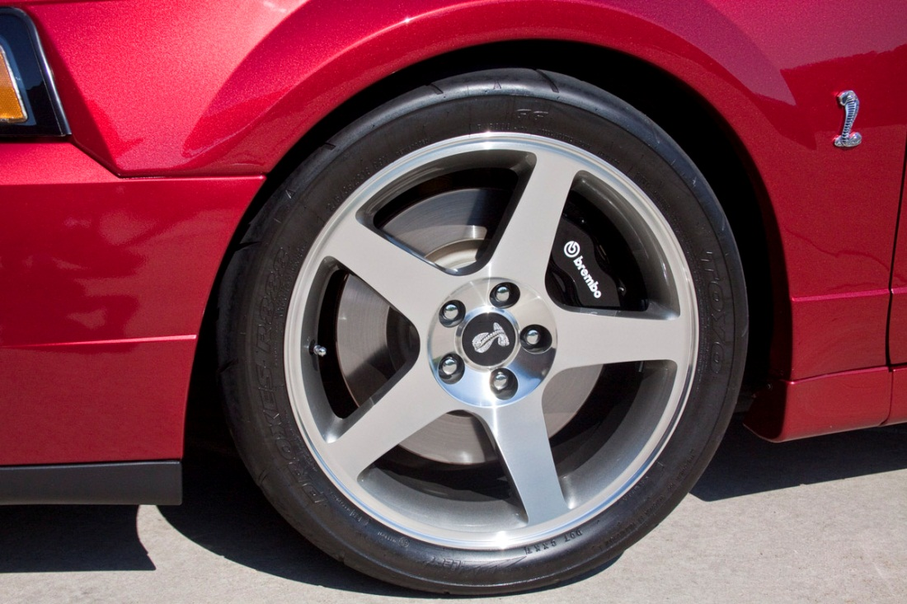
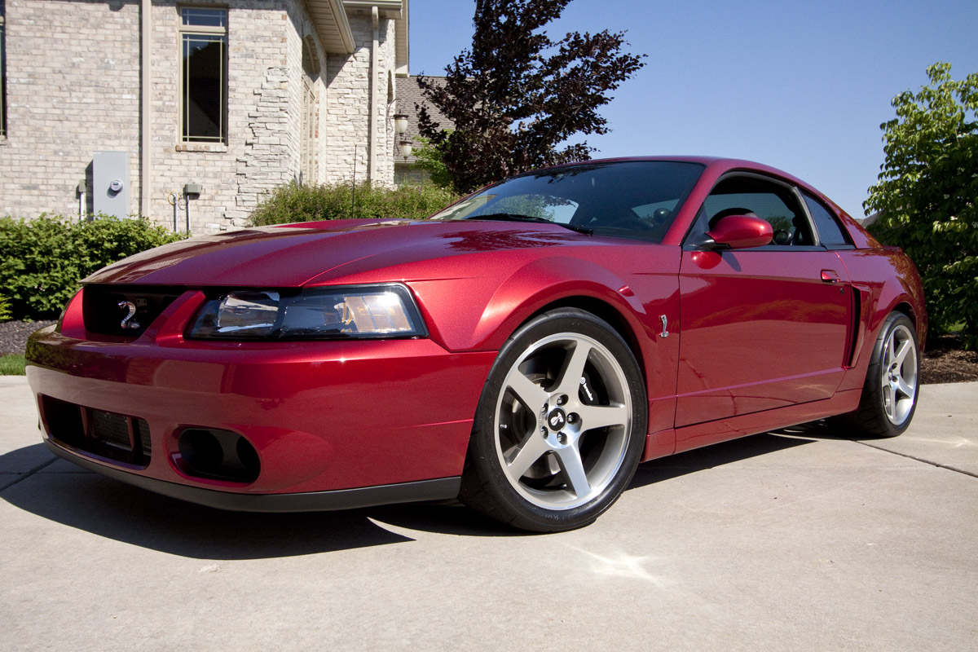

Slide 8
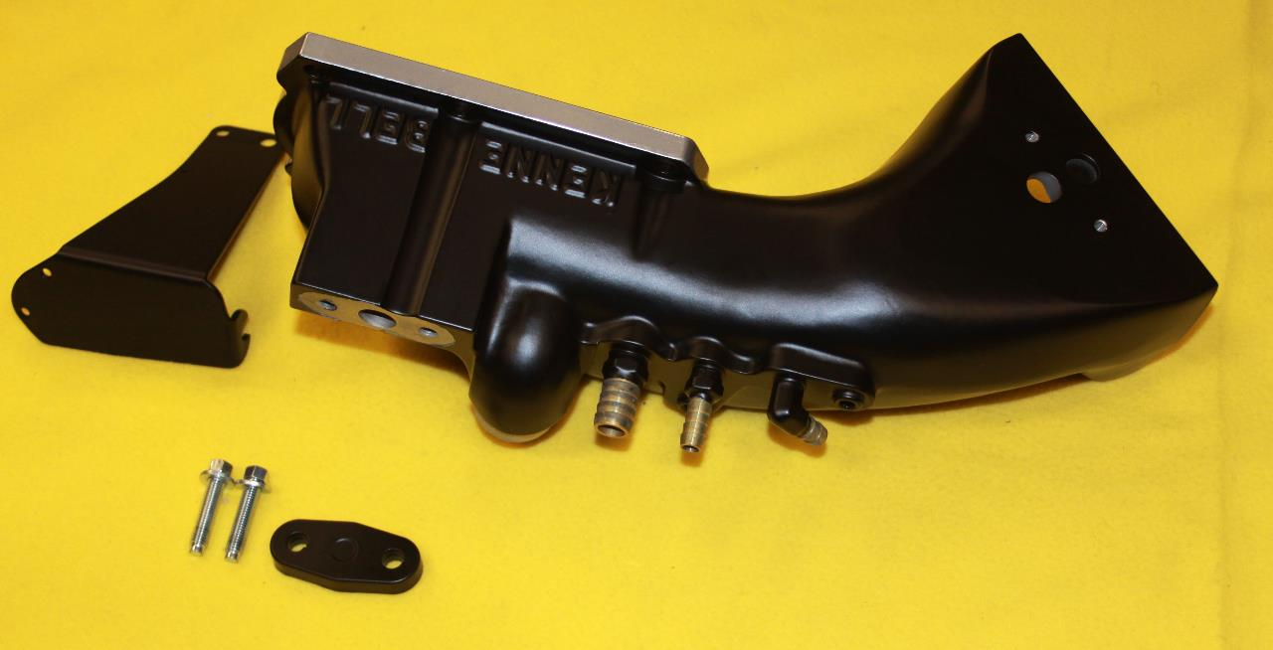
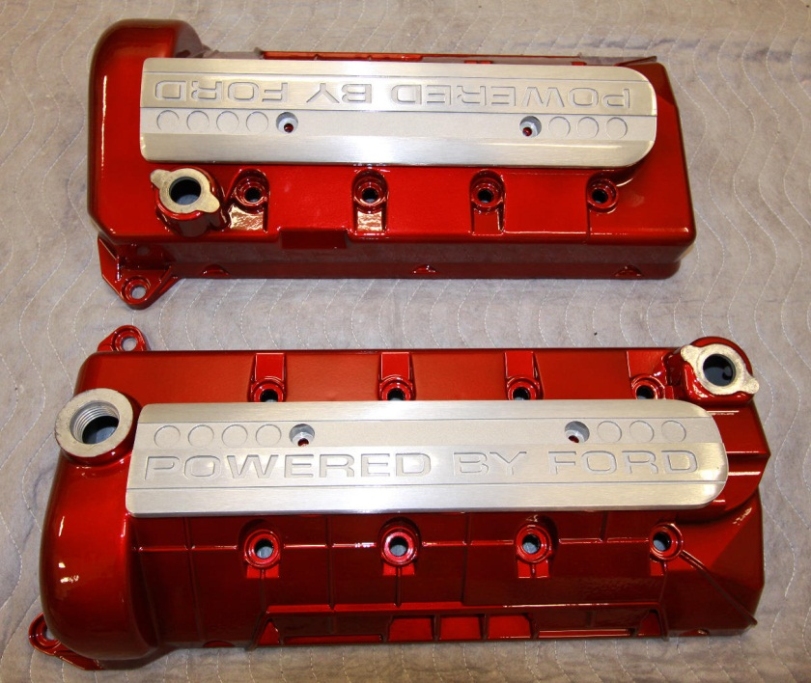
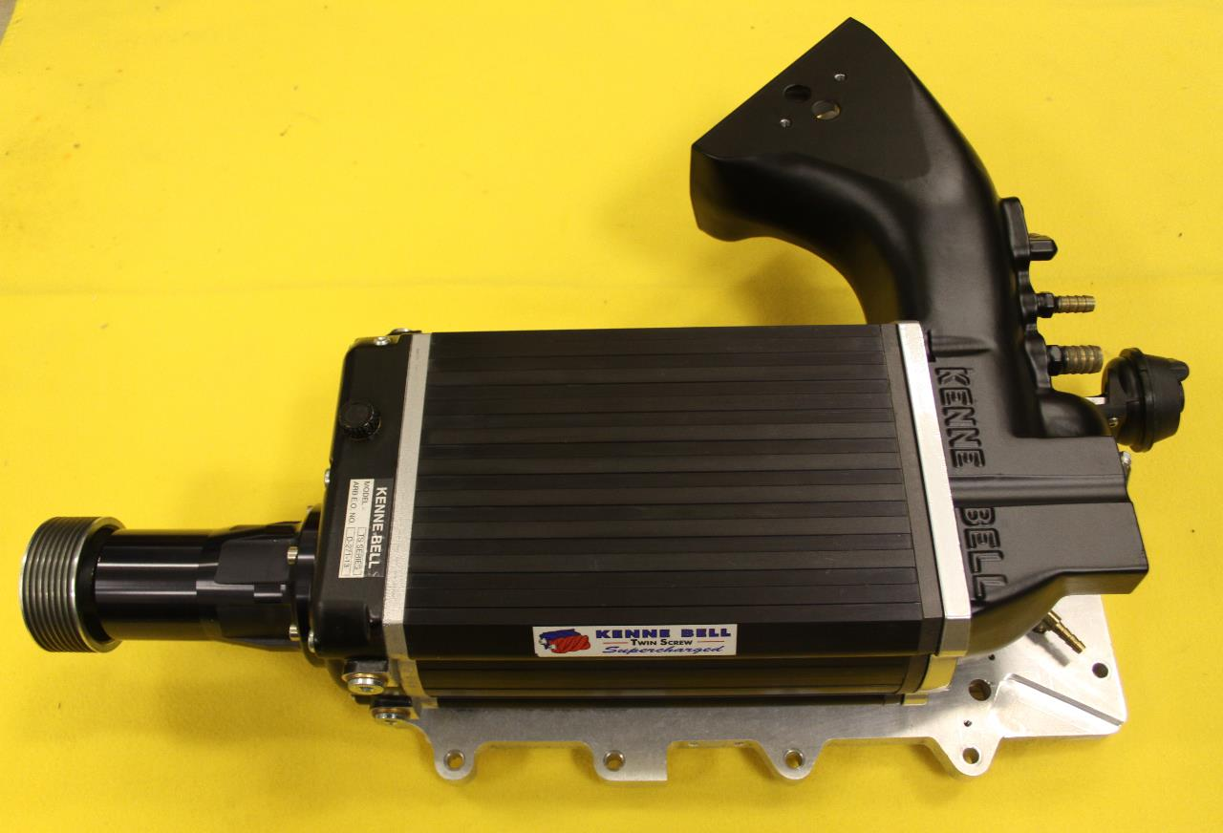
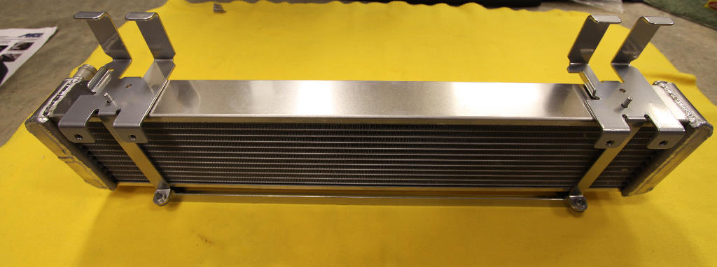

Slide 9
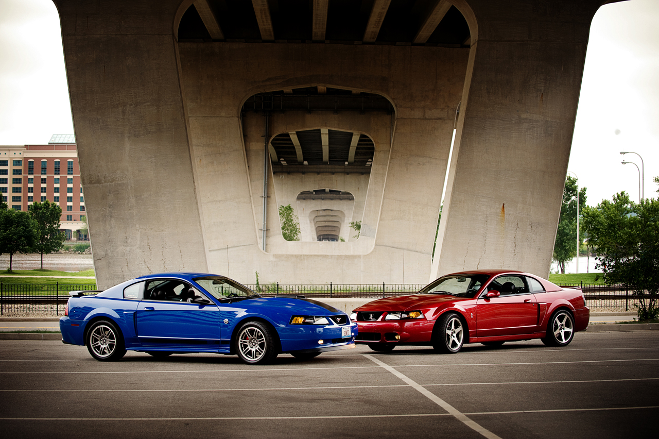

Slide 10
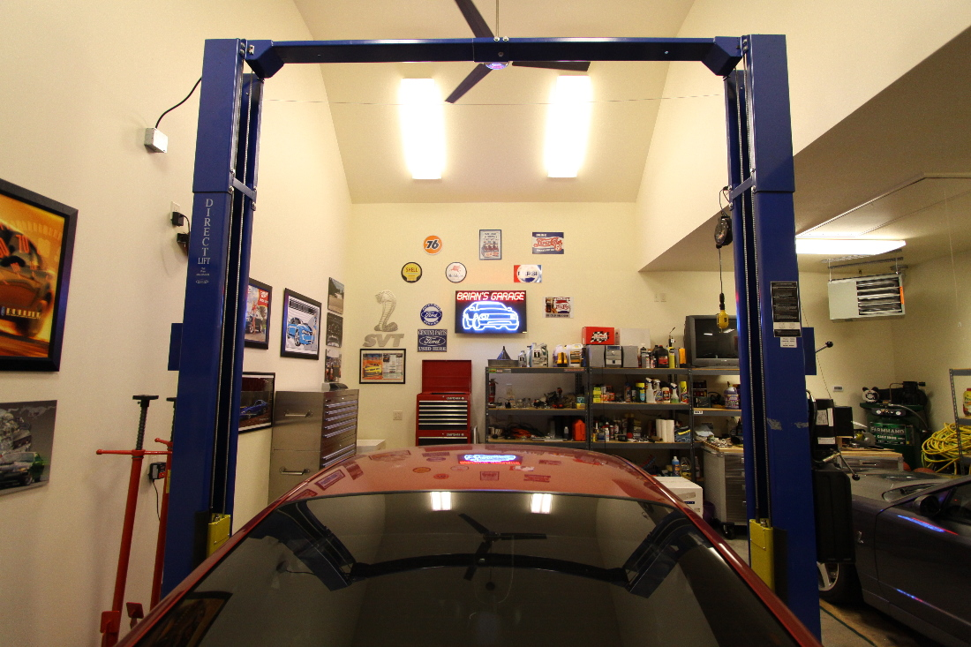

Slide 11
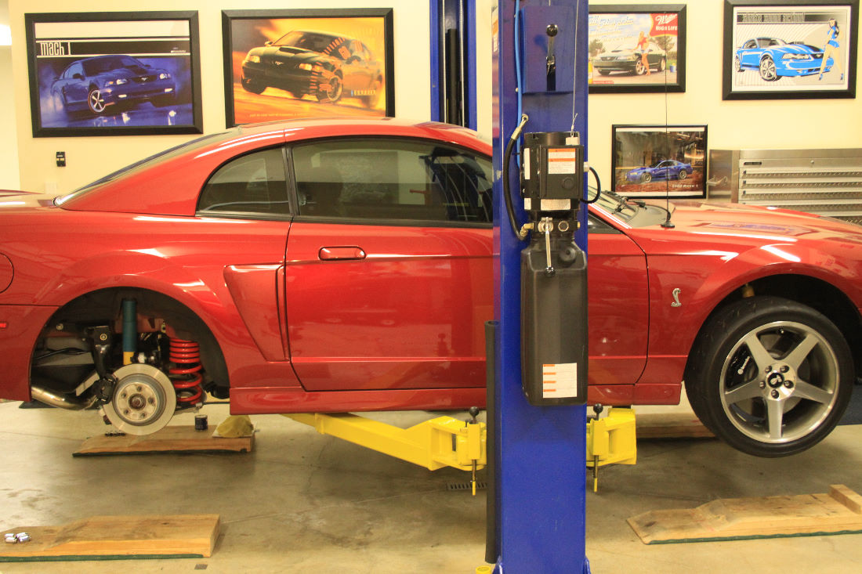

Slide 12
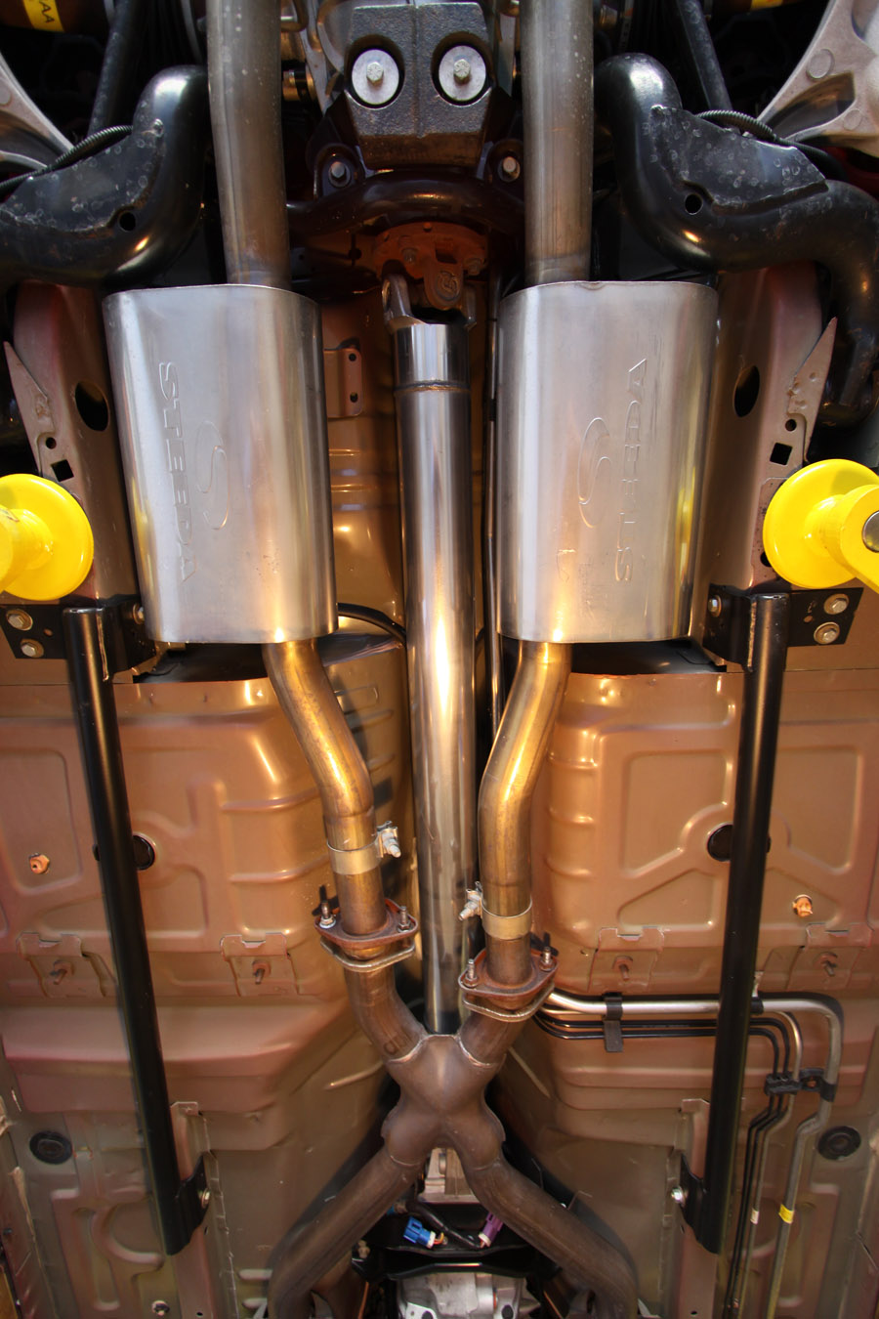

Slide 13
Car Show Presentations

Slide 14
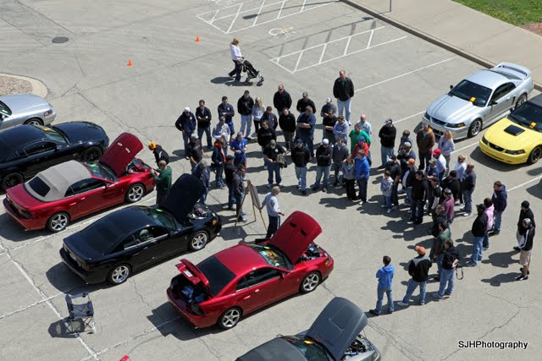

Slide 15
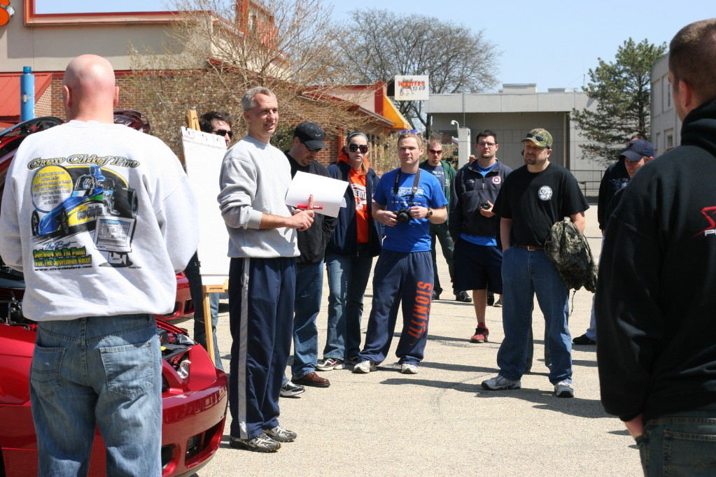

Slide 16
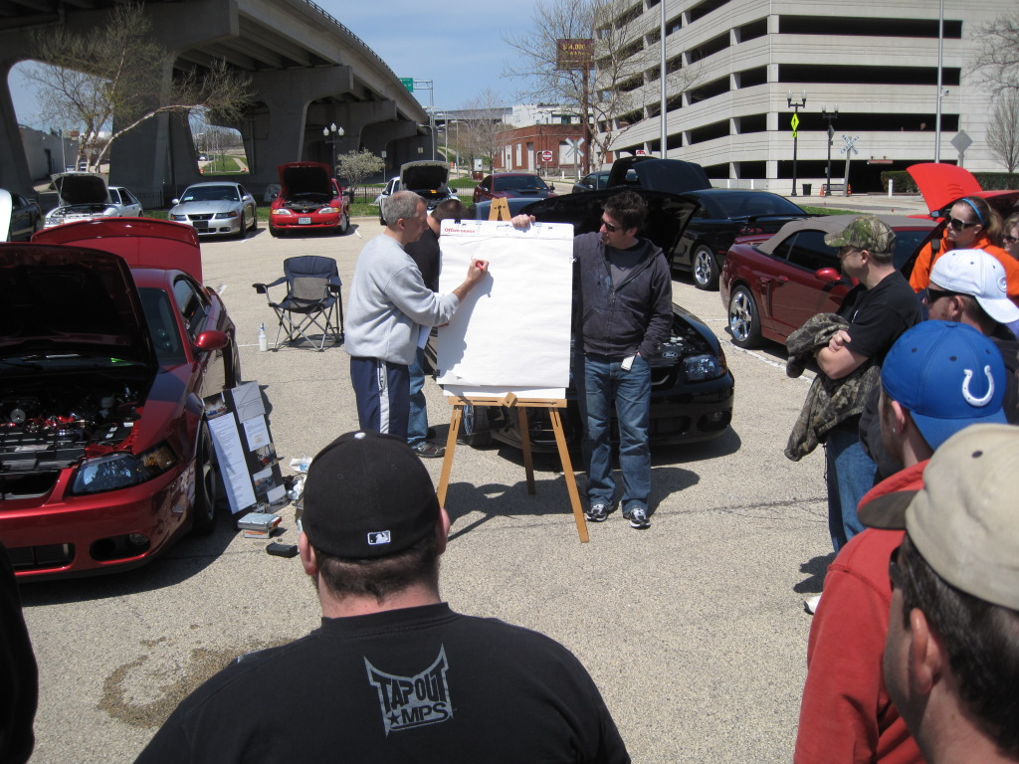

Slide 17
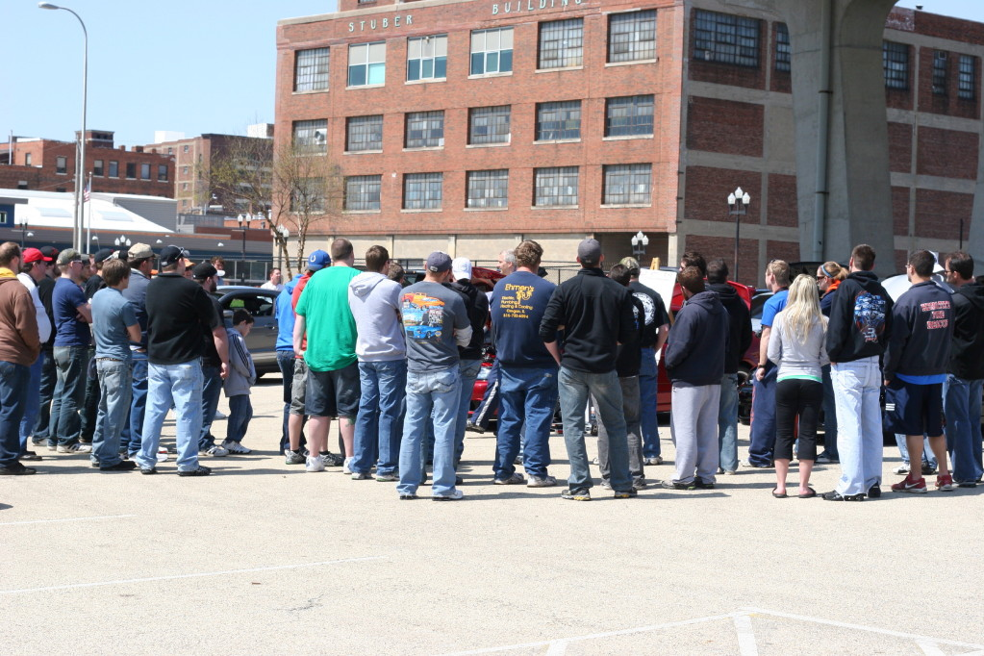

Slide 18
My Ford Career

Slide 19
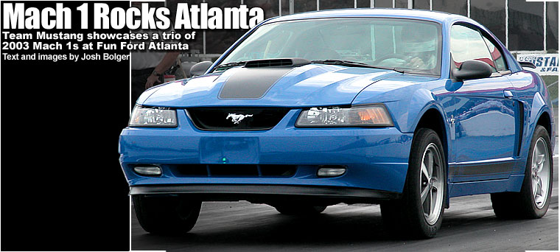
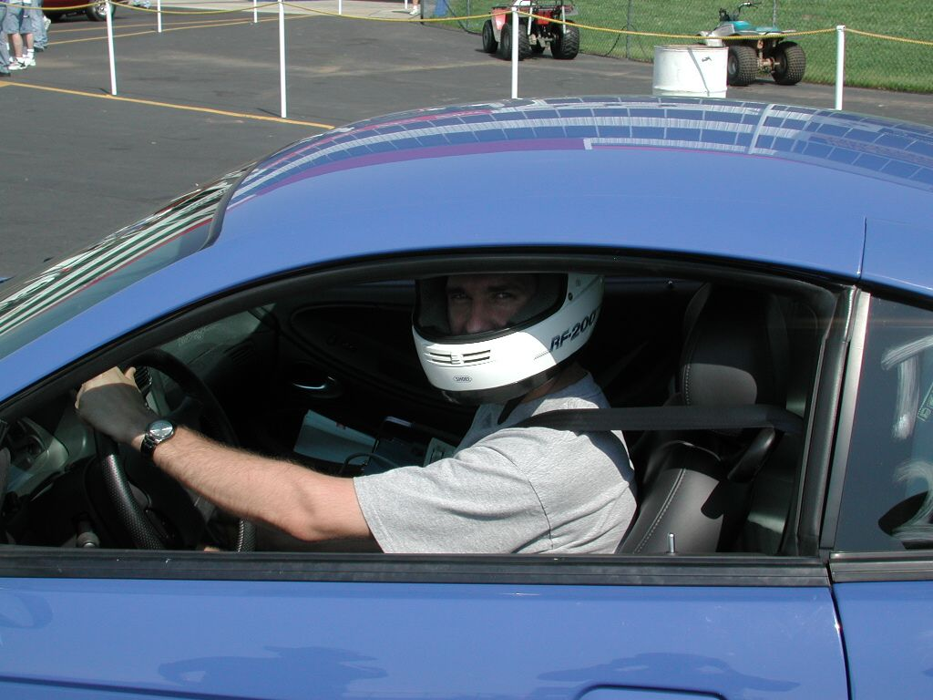
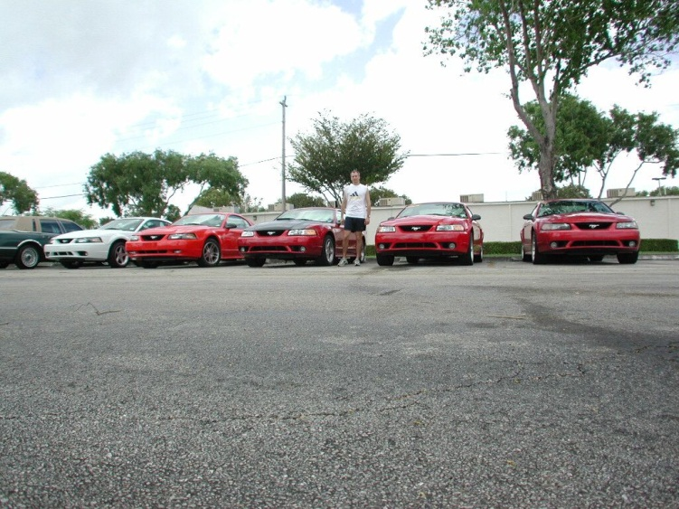
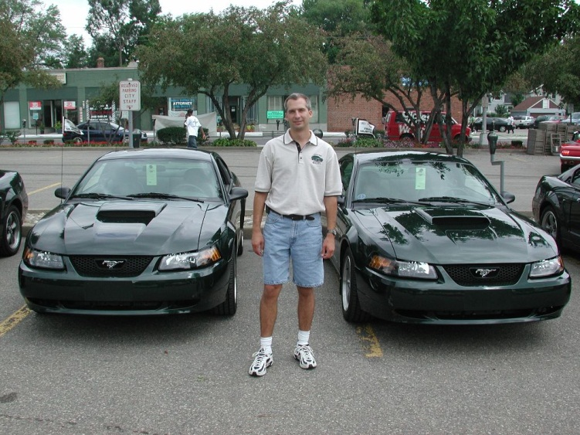

Slide 20
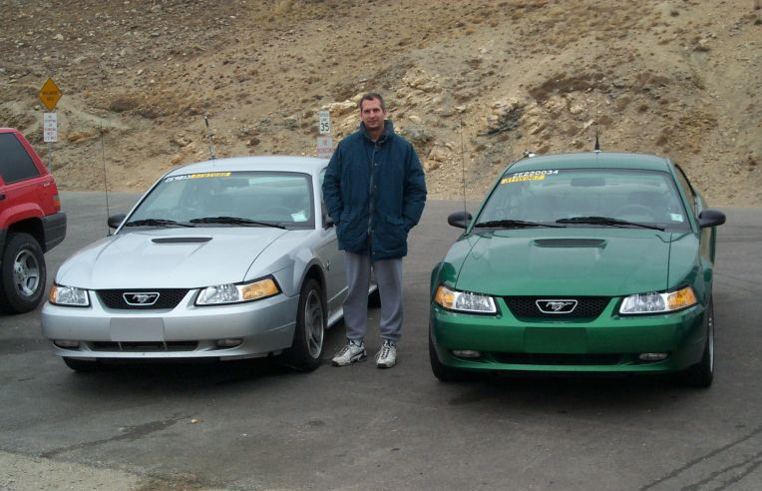
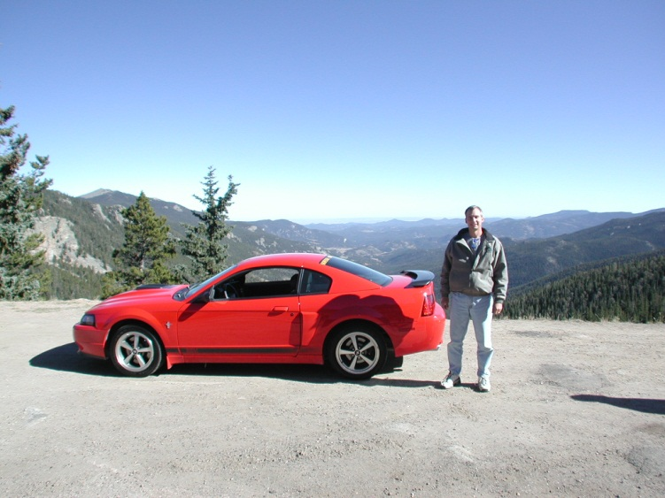
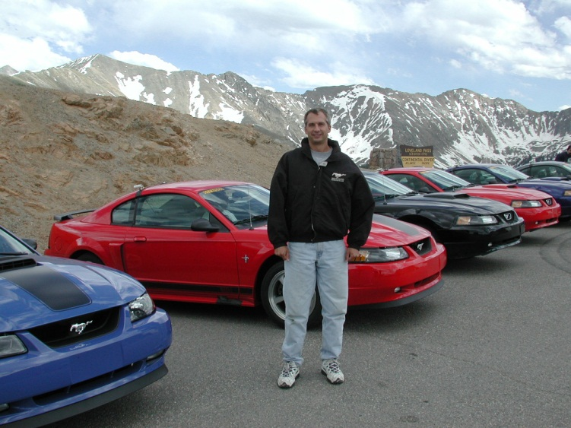
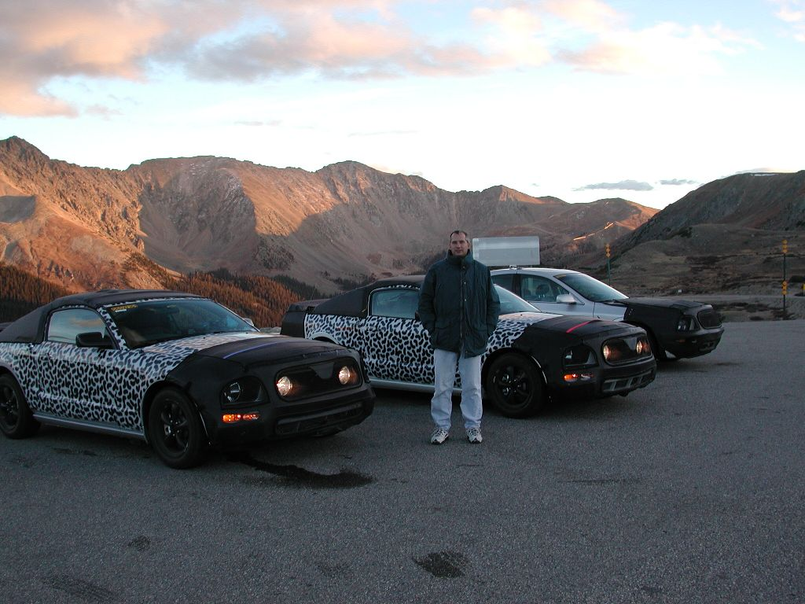
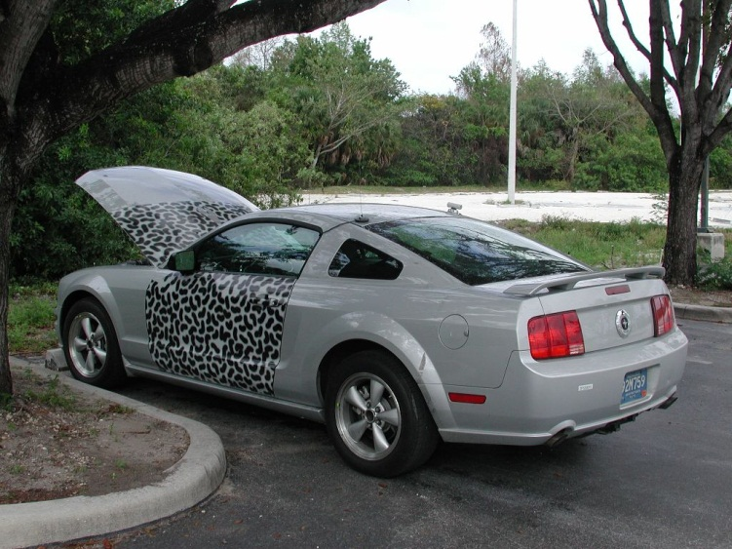

Slide 21
